Slide 1



DELIVER
Strategic
And Business
Planning

Slide 2
DELIVER
Strategic and Business Planning
 | Pre-workshop study | Programme Objectives
 | Fundamentals of Strategic Planning | To understand what are the basics of strategic planning in an organisation
 | Strategy and strategic prioritization tools | To acquire new knowledge on the different tools on strategy and prioritisation
 | Identifying success factors and criteria | To learn how to develop good success criteria
 | Practical business planning | To develop a good understanding of the basics and importance of business planning
Notes:
Need to check review these.

Slide 3
Strategic and Business Planning Part 1: Fundamentals of Strategic Planning, Prioritization and Embedding prioritization behaviours

Slide 4
Self-assessment Strategic Thinking, Acting and Influencing
Please answer the self-assessment questionnaire to reflect on your personal strategic profile.
You may share with the other cohorts your results and discuss your scores and highlight strong and weak points.

Slide 5
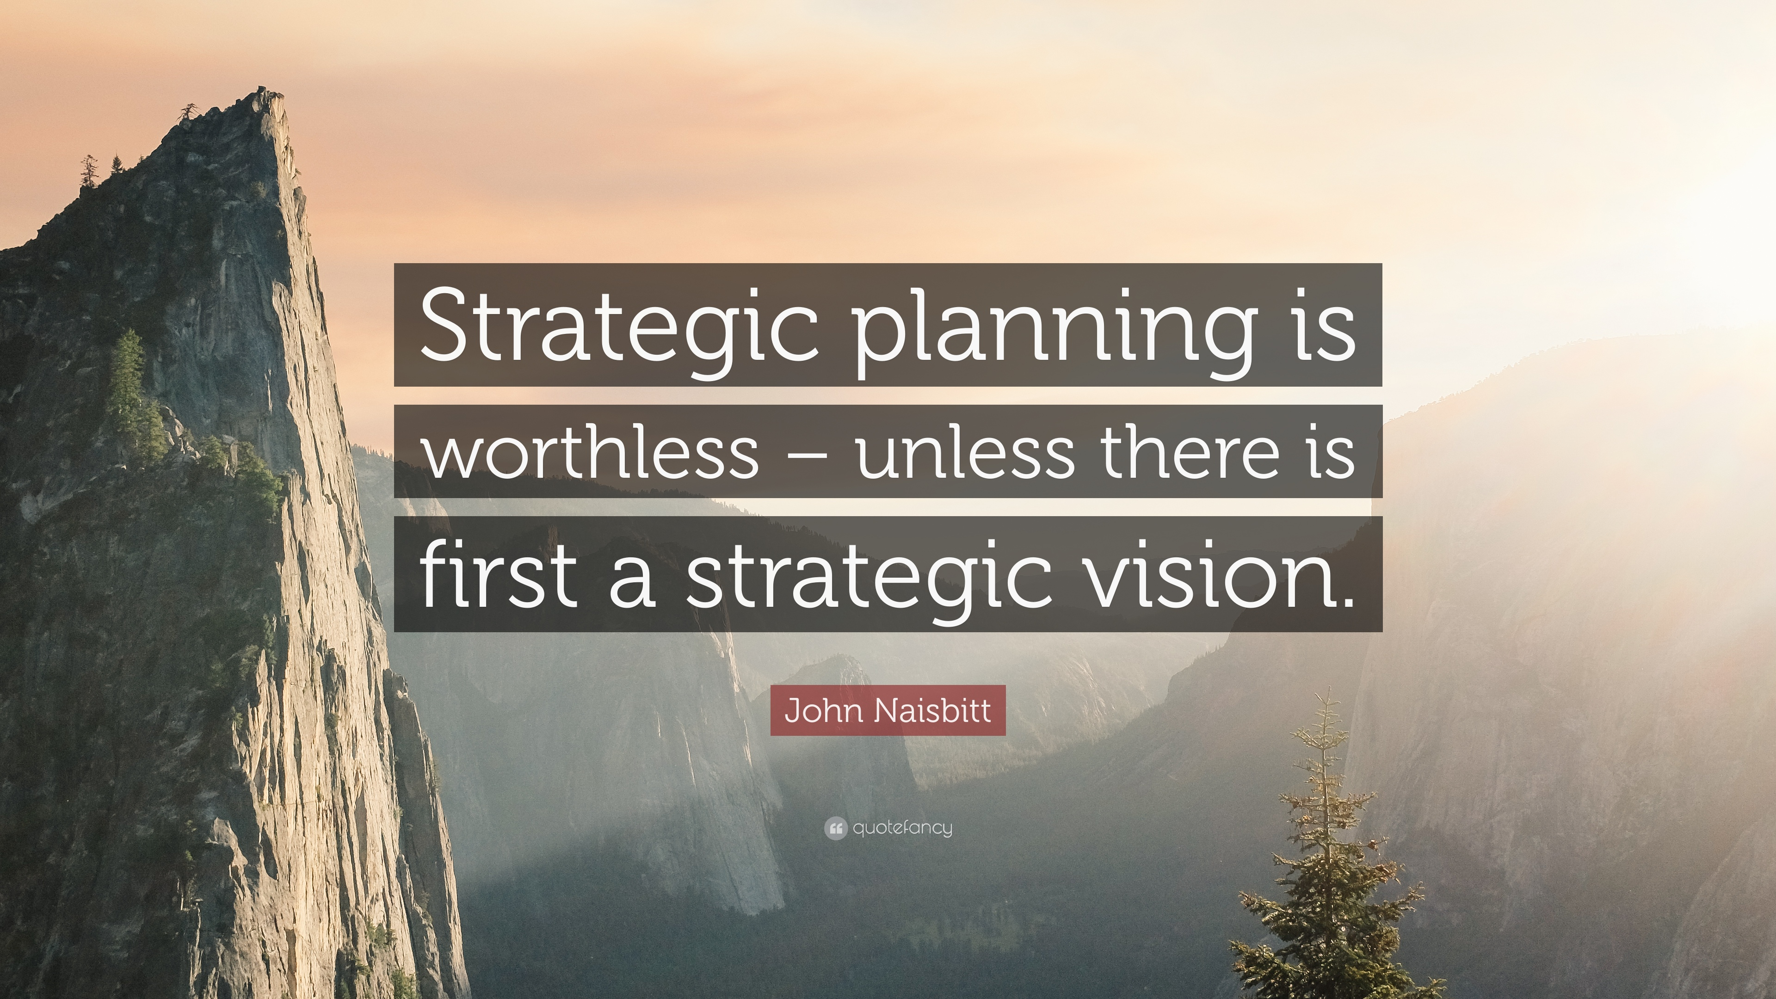
Strategic Vision
"It is wisdom to know others; it is enlightenment to know one's self.”
– Lao-Tzu, Chinese philosopher
Notes:
Need to check review these.

Slide 6

From the LEAD Module we discussed how important it was to lead with a vision…
Leading with a vision
It’s important to have a compelling vision and a comprehensive plan. Positive leadership — conveying the idea that there is always a way forward — is so important because that is what you are here for — to figure out how to move the organization forward. — Alan Mulally
Notes:
Need to check review these.

Slide 7



REMEMBER THIS?
How Great Leaders Create and Share an Inspiring and Positive Vision
In order to rally people to follow you, you must be able to articulate and communicate your vision in a simple, clear, bold, and compelling way.
1. A North Star
The vision a positive leader creates and shares serves as a North Star that points and moves everyone in an organization in the right direction. The leader must continually point to this North Star and remind everyone that this is where we are going.
2. A Telescope and a microscope
The telescope helps you and your team keep your eyes on your vision, North Star, and big picture. The microscope helps you zoom-focus on the things you must do in the short term to realize the vision in your telescope
Notes:
Need to check review these.

Slide 8

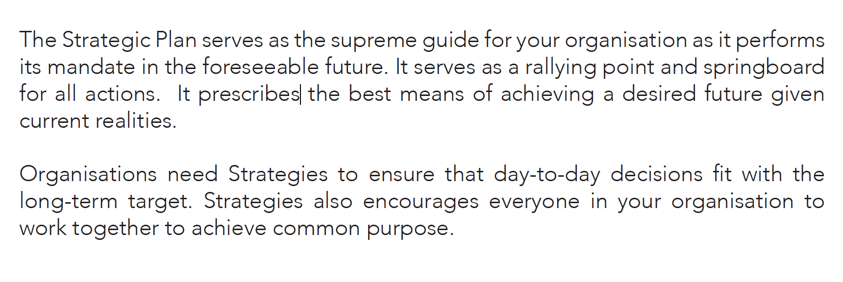
Why do organisations need a Strategic Plan?

Slide 9
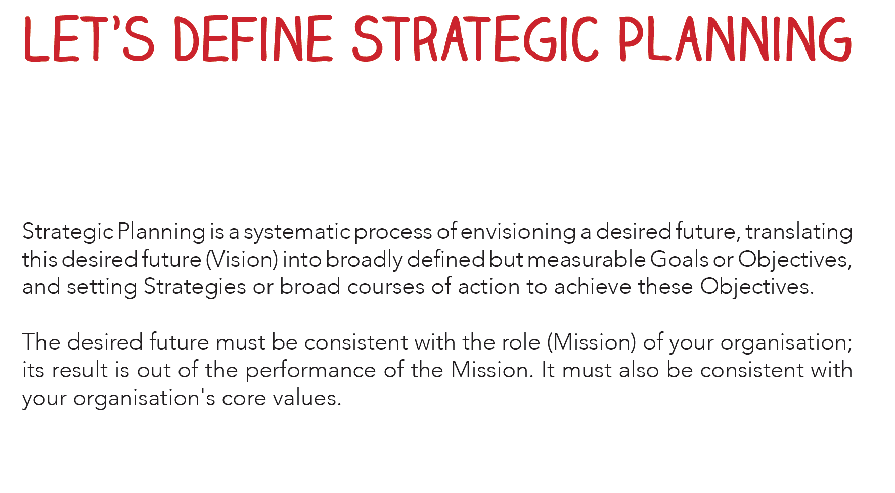
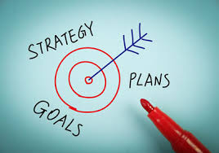
Note: We will discuss strategic planning in detail at the workshop

Slide 10
Three Levels of Strategy
Corporate Strategy
Corporate strategy refers to the overall strategy of an organization that is made up of multiple business units. It determines how the organization as a whole supports and enhances the value of the business units within it; and it answers the question, "How do we structure the overall business, so that all of its parts create more value together than they would individually?”
Business Unit Strategy
Your business unit strategy will likely be the most visible level of strategy within each business area. People working within each unit should be able to draw direct links between this strategy and the work that they're doing. When people understand how they can help their business unit "win," you have the basis for a highly productive and motivated workforce. As such, it's important to have a clear definition of the business unit's mission, vision and values.
Team Unit Strategy
To execute your corporate and business unit strategies successfully, you need teams throughout your organization to work together. Each of these teams has a different contribution to make, meaning that each team needs to have its own team-level strategy, however simple.
This team strategy must lead directly to the achievement of business unit and corporate strategies, meaning that all levels of strategy support and enhance each other to ensure that the organization is successful.
Notes:
Need to check review these.

Slide 11
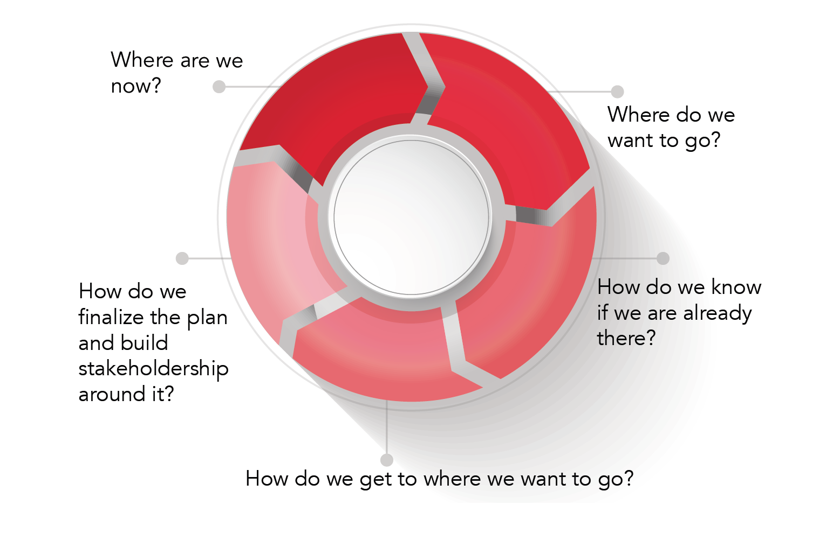
What Does Strategic Planning Look Like?

Slide 12

Reflection…
Please reflect on the following questions below:
Get a copy of the LGU’s vision and strategic plan
Is the strategic plan clear?
Do you have a team strategy or business plan? Team strategy/plan?
Does your team strategy align with the departmental plan and does the departmental plan align to the LGU’s strategic vision?

Slide 13

Strategic focus
It is important to set your direction and prioritize your efforts to have the greatest impact with the work that you do. Creating strategic focus will help you say no to distractions, be more efficient, and leave your team feeling like the work they do matters.
Please watch the two videos on Strategic Focus by Mike Figliulo of thoughtLeader then do the focus assessment task.
The importance of strategic focus (video 0)
Creating the impact of focus (video 1)

Slide 14
What Focus Requires
Clarity of direction
Criteria for decision-making
Continuous prioritization
Willingness to say no

Slide 15
Task: Focus Assessment
Inventory your team’s projects
Estimate weekly project hours
Add up available weekly hours (remove things like meetings, email and other unproductive time)
If the first number is bigger than the second then you may have a problem. You might not be saying no to distractions
Revisit your business cases from your top five projects from last year
Ask did those projects hit their impact projections?
If not you have a problem – you are not delivering quality work because you are spread too thin
Did any of the projects win award or gain recognition?
If not, you may not be working on the most meaningful projects
Notes:
Need to check review these.

Slide 16

Guiding Principles and Strategic Filters
Please watch the videos below:
Setting the vison and mission strategic focus(video 3)
Guiding Principles and Strategic Filter(video 4)
The guiding principles and strategic filters are the criteria for assessing which work you'll do, which work you won't do, and the prioritization of your efforts. Some filters will be quantitative and others will be qualitative. What matters most is that you use these filters to assess any new project you're considering.

Slide 17
Setting the Direction
Start with your strategic plan
Look at your vision and mission
Write three to five guiding principles
Build five to ten strategic filters

Slide 18
Prioritizing Work and Driving Behaviours
A consistent and regularly-scheduled prioritization process helps eliminate distractions and focus your efforts on the most meaningful projects. Some processes are formal while others are simply frequent conversations about priorities.
There may be a time that you also need to readjust focus which can be done through:
Reassessing Work
Evaluating New Opportunities
Shifting focus
Watch the following videos
Running a prioritization process (videos 5 and 6)
Embedding prioritization (video 7)
Asking yourself should 1 (video 8)
Challenging the team (video 9)

Slide 19
Implement a prioritization process
Draw the line: stop doing work that is off strategy
Embed focusing behaviours in your organisation
Routinely challenge new work
Communicate your rationale for your decisions

Slide 20
Embedding Prioritisation
Ask people what they are working on
Explain how their work ties to the overall strategy
Make choices based on the strategy

Slide 21
Pitfalls and Next Steps
Not clearly setting direction
Failure to rigorously prioritize
Getting distracted by new opportunities
Not regularly reassessing your priorities
Please watch the videos below:
Ptifalls (video 10)
What next (video 11)

Slide 22
Strategic and Business Planning Part 2: Execution and Performance Management

Slide 23

Why Strategies Fail
Company initiatives don’t aligned with strategy
Company processes don’t align with strategy
Employees and stakeholder fail to engage

Slide 24
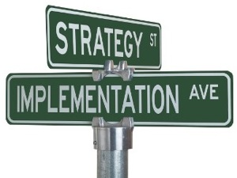
Successful Strategy Implementation Guide
Align your initiatives
A key road to failed implementation is when we create a new strategy but then continue to do the same things of old. A new strategy means new priorities and new activities across the organisation. Every activity (other than the most functional) must be reviewed against its relevance to the new strategy.

Slide 25
Successful Strategy Implementation Guide
2. Align budgets & performance
Each department should allocate and manage the budgets to deliver the division’s strategic initiatives. Organisational performance should be closely aligned to strategy.
Performance measures should be placed against strategic goals across the organisation and each division and staff member. All staff will have job functions that will impact on strategy. Most staff will have impact across a series of strategic goals Ensure employees are aware of their role and influence on strategy delivery and performance. This is also important to employee engagement

Slide 26
Successful Strategy Implementation Guide
3. Structure follows strategy
A transformational strategy may require a transformation to structure. Does the structure of your organisation allow strategy to cascade across and down the organisation in a way that meaningfully and efficiently delivers the strategy?
Organisations that try and force a new strategy into an out-dated structure will find their strategy implementation eventually reaches a deadlock

Slide 27
Successful Strategy Implementation Guide
4. Engaging Staff
Prepare: Strategy involves change. Change is difficult and human tendency is to resist it. So no matter how enlightened and inspiring your new strategic vision, it will come up against hurdles. It is important we understand each of these hurdles and develop strategies to overcome them.
Include: Bring influential employees, not just executive team members into the planning process. Not only will they contribute meaningfully to strategy, they will also be critical in ensuring the organisation engages with the strategy. Furthermore, listen across the organisation during strategy formulation. Some of your best ideas will come from within your organisation, not the executive team
Note: We will talk about change management in projects in details in the workshops

Slide 28
Successful Strategy Implementation Guide
4. Engaging Staff
Communicate: Ensure every staff member understands the strategic vision, the strategic themes and what their role will be in delivering the strategic vision.
The vision needs to give people goose bumps – a vision they believe in, that they want to invest and engage with.
Clarify: It is important that all employees are aware of expectations. How are they expected to change? What and how are they expected to deliver?

Slide 29
Successful Strategy Implementation Guide
5. Monitor and Adapt
A strategy must be a living, breathing document.
To succeed the whole organisation must engage with it and live and breathe it. Strategy should inform our operations, our structure, and how we go about doing what we do. It should be the pillar against which we assess our priorities, our actions and performance.
When execution is brought into strategic planning we find that our strategy is weaved through our organisation, and it’s from here that great leaps in growth and productivity can be achieved.

Slide 30



Three Cs of Implementing Strategy
Clarify your strategy:
clarify your strategy in a way that people in your organization can rally to support its implementation. Done well, this strategy will tie together your goals and objectives and clearly explain what you intend to do.

Slide 31

Three Cs of Implementing Strategy
2. Communicate your strategy
Powerfully communicating the essence of your strategy at every level of the organization using multiple mediums. Use internal blogs and message boards, brown bag luncheons, podcasts, and department meetings to communicate what the strategy is and how everybody’s work is informed by that strategy.
Discussions need to occur at each level, translating the organization’s strategy to understandable and contextualized sound bites, which connect to the work of individuals. In short, communicating the strategy provides the “connective tissue” throughout the organization that helps people understand the big picture.

Slide 32

Three Cs of Implementing Strategy
3. Cascade your strategy
If you want your strategy implemented well, cascade it throughout the organization and get to the practical and tactical components of people’s jobs every day. Involve your managers in the process
Help them translate the elements of the strategy for your organization to their own functional areas. Doing this allows them to develop and own the process of cascading the strategy and designing implementation plans with high likelihood of execution. The bulk of the work in implementing strategy is done at this stage.
It is the team meetings, the one-on-one coaching, the process improvements, the customer meetings, and the responses to the market that, in alignment with an organization’s strategy, can make a tremendous difference for an organization.

Slide 33
Strategy Execution:
Improving the Implementation of Your Strategy
Read the article Simon’s Seven Strategy Questions

Slide 34
Performance Management and KPIs Linking Activities to Vision and Strategy
Vision
Strategy
Objectives
Critical Success Factors
KPIs
Actions

Slide 35
Performance Management and KPIs Linking Activities to Vision and Strategy
KPIs are metrics that link organizational vision with individual action. If you think of strategic practice as a pyramid, as shown in the previous slide, with vision at the top and actions at the bottom, in the middle you find the KPIs that have been derived from the strategy, objectives, and critical success factors of the organization.
Below the KPIs are the activities and projects that are pursued by the organization in an attempt to achieve the KPIs.
To ensure that these activities are in fact aligned with the organization's strategy, you need to concentrate on what the employees are actually doing. You do this through performance management. By applying the principle of KPIs to employee goals and performance, you create a direct link between all of the key success factors that have been derived from the overall strategy. The result is that members of your team actually do what they should be doing, and that your measurements for determining how well they are doing are clearly tied to organizational success.

Slide 36
TASK
Building and implementing your perfect performance management process
Watch 4 TED talk videos of performance management. Reflect on key learnings from each video and how you may apply this in your team. Share with other cohorts
Performance Management will be tackled more at the face to face workshops picking out key insights from the videos.

Slide 37
But how do we motivate our employees to perform better?
Watch the 4 Ted Talks on Performance Management
The Puzzle of Motivation by Dan Pink is one of the most popular TED Talks of all time. (18.26 minutes)
Dan's big idea is based on what he calls ‘intrinsic motivation’ — the desire to do things because they matter, not because we’ll be paid more. Traditional rewards aren't always as effective as we think
Dan lays out a new business model based on three essential components for employee success: Autonomy, Mastery and Purpose. If you can come up with creative ways to use these tools, you can make your employees feel more motivated than money ever could.
One way to nurture greater autonomy at work is to rely on your performance management process to check in regularly, but not too regularly. When you get the timing right, you reduce your risk of falling into a culture of micromanagement.
https://www.ted.com/talks/dan_pink_on_motivation?language=en#t-7553

Slide 38
But how do we motivate our employees to perform better?
2. What Makes us Feel Good About our Work by Dan Ariely
Watch time: 20 minutes
“Ignoring the performance of people is almost as bad as shredding their effort in front of their eyes.”
Behavioral economist Dan Ariely dives deep into the relationship between motivation, meaning and productivity..
Dan presents seven key principles that underpin employee satisfaction: Meaning, Ownership, Creation Challenge, Pride and Identity
In one simple example of how to help employees develop a sense of ownership, take a look at how prototype optics manufacturer Optimax uses peer reviews. Under the right circumstances, peer reviews can not only help identify areas for development, they can also help your team feel a sense of collective support for your performance management process.
https://www.youtube.com/watch?v=5aH2Ppjpcho

Slide 39
But how do we motivate our employees to perform better?
3. The Happy Secret to Better Work by Shawn Achor
Watch time: 9 minutes
“It’s not just the reality that shapes us but the lens through which your brain views the world that shapes your reality.”
By switching into a present, positive mindset, employees and managers can experience what Shawn calls the ‘Happiness Advantage.’ With this performance power tool, employees can essentially harness the happiness hormone, dopamine, to become smarter, faster and more successful at work, without stressing out about it.
In your employee reviews, there are always questions about what’s gone well. But if you really want to tap into the 'Happiness Advantage', you need to narrow down the focus to what's good about the present. One way to do this is to simply ask employees what aspects of their work they feel the most grateful for.
https://www.youtube.com/watch?v=fLJsdqxnZb0

Slide 40
But how do we motivate our employees to perform better?
4. Forget the Pecking Order by Magaret Hefferman
Watch time: 15 minutes
“Companies don’t have ideas only people do.”
Margaret Hefferman poses a radical idea: it’s not leaders that save the day but the team.
Bonds and trust we develop with each other is a key driver of outstanding employee performance. Yet many companies ignore this. Leadership has been conditioned to create a competitive environment that values the "stars" rather than the group.
For those of us who see the importance of social cohesion at work, we often we assume it'll happen organically. But it doesn’t.
So how do you overcome this age-old culture of competition?
A great starting point is to encourage peer-to-peer recognition. For instance, the healthy snack delivery company Snacknation has ‘crush’ Friday, where employees are encouraged to publicly praise each other by simply calling out someone on the team who's really "crushing it". And it doesn’t matter if it’s for finishing a massive project or simply a small act of kindness. All crushes count.
https://www.ted.com/talks/margaret_heffernan_why_it_s_time_to_forget_the_pecking_order_at_work?language=en

Slide 41
THANK YOU

